Slide 2

LOGIN PAGE USING DJANGO
CELEBAL INTERNSHIP 2021 PROJECT
Vanshul Gupta Kunal Bhardwaj Vikrant Rajput Rakshita Sharma
R100218071 R100218027 R111218057 R111218064
Under the guidance of Mr. PUSHPENDRA K RAJPUT

Slide 3
INTRODUCTION
This page lets user register using username, password, email address and phone number. It also lets the user sign in during sessions and at last log out the user. Have use python Django to build this page and used libraries like pillow. One of the nicest things we like about using Django was that while it provides lot of functionality out of the box, it's designed to be customizable too.It is a collection of three important components Model View and Template. The Model helps to handle database. It is a data access layer which handles the data. The Template is a presentation layer which handles User Interface part completely. The View is used to execute the business logic and interact with a model to carry data and renders a template.

Slide 4
PROBLEM STATEMENT
To Make a registration page and register a new user using username, password and email address.
Making a Signup page to sign in the user using sessions and then logout the user.

Slide 5
OBJECTIVE
The Aim of this project is to develop a reliable webpage using Django where user can login using their credentials in sessions.
Implement a Login page & Registration with the help of python django
Store the data on database (PostgreSQl)

Slide 6
What’s New?
Developer is flexible to make change in registration page without make chages in code.
2) Having Session timeout function that help to reduce the stress on the server

Slide 7
Target Audience
We will target all age group, if we combine our page with any Social media platform.In this era everyone use social media and very sensitive for their personal data.

Slide 8
Technology Used
Visual Studio Code v.1.59
Django
GIT
Python 3.9
HTML5
CSS

Slide 9
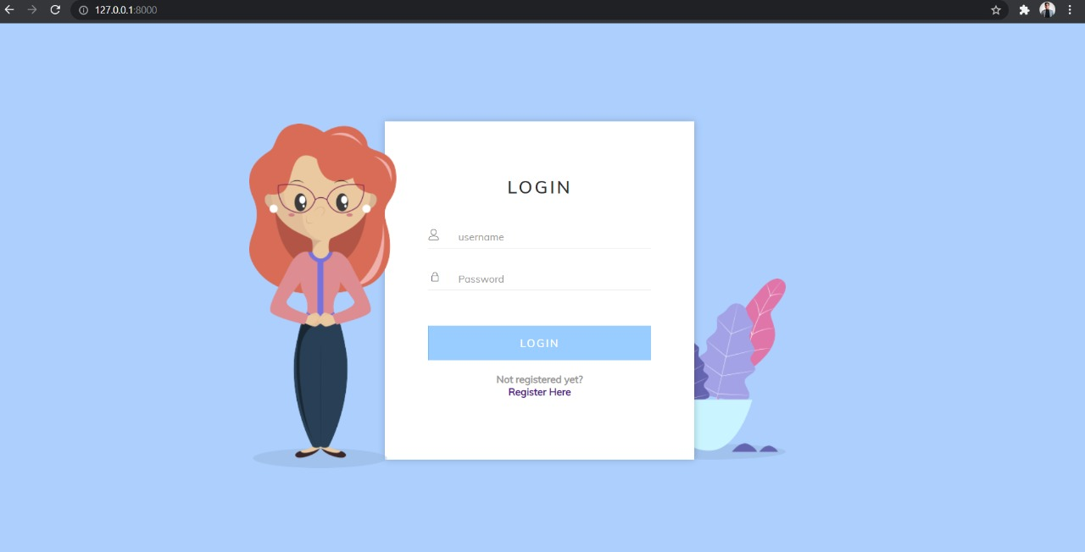
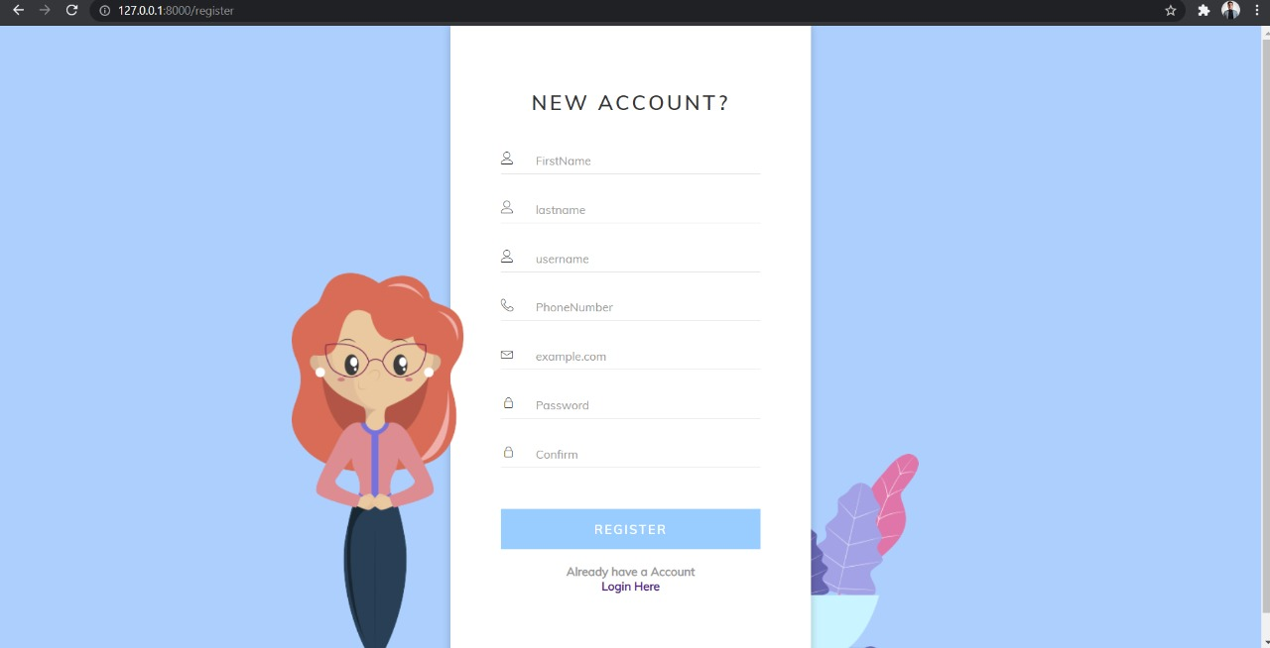
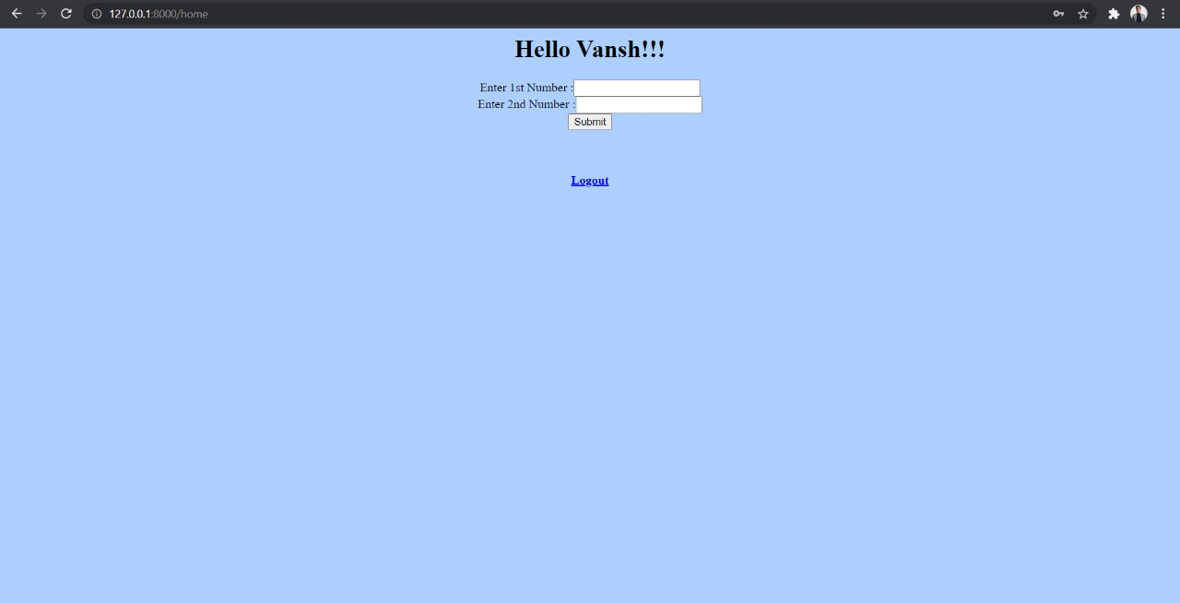
Project Demostration

Slide 10
Future Scope
1)We will integrate this page with AWS so that every time user gets a mail on register email id when someone login to the account.
2)It will tell the basic information of the login user example: IP address ,Location.

Slide 11
Conclusion
Our project allows the user to register itself and login using those credentials in sessions. Verify if a user will be able to login with a valid username and valid password. Verify if a user cannot login with a valid username and an invalid password.

